Slide 1
Progressive Web Apps
Group 4

Slide 2
Team Members
Ali Al Ali
Dylan Rongey
Terry Woosley
Xizi Chen

Slide 3
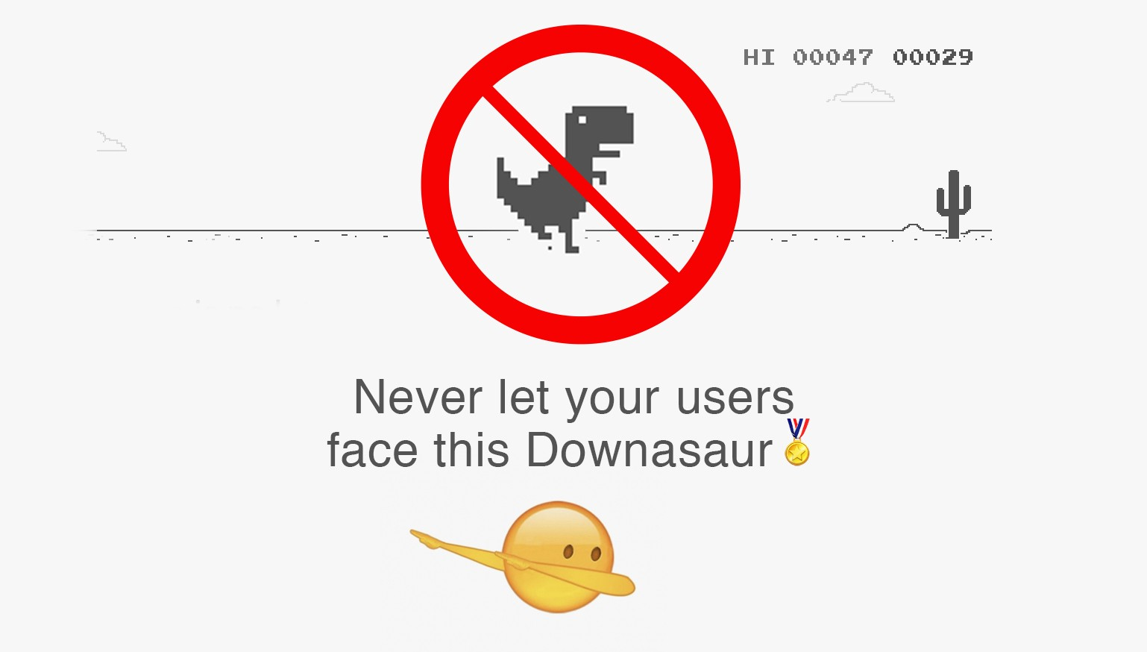
What is a PWA?
Progressive Web Apps are user experiences that have the reach of the web, and are:
Reliable - Load instantly and never show the downasaur, even in uncertain network conditions.
Fast - Respond quickly to user interactions with silky smooth animations and no janky scrolling.
Engaging - Feel like a natural app on the device, with an immersive user experience.
A PWA is just a regular web app which attended the
best university and mastered user experience🎓

Slide 4

What are the components of a PWA?
PWA has some important technical components which work together and energizes the regular web app. The following components are required to develop a good PWA.

Slide 5
Service Worker
Service worker is a component of JavaScript code which works as a proxy between the browser and the network. It runs in the background and enable a developer to intercept network requests.
Service worker also manages the push notifications and helps to build the offline web application using the browser’s cache API.

Slide 6
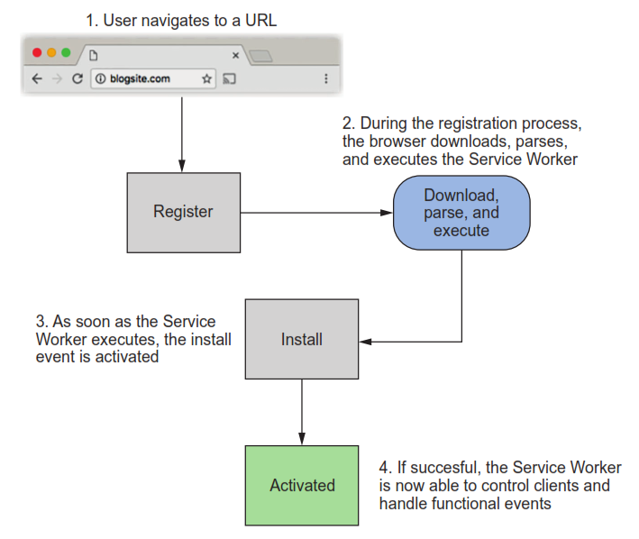
Service Worker lifecycle

Slide 7
Manifest.json
The web app manifest is a simple JSON file that tells the browser about your web application and how it should behave when 'installed' on the user's mobile device or desktop.
Icon
Screen Orientation
Fullscreen

Slide 8
HTTPS
HTTPS is a required secure protocol for PWA. When there is no network, Service Workers can intercept the network request and be able to modify the responses. All the actions can be performed on the client side.

Slide 9
How to implement a PWA?
Create manifest.json to provide information about your app.
Create favicons and a full set of icons (users can install a PWA on their devices)
Create service-worker.js
Add index.html links and icons to manifest.json
Add index.html script to register a service worker running independently, capable of intercepting all fetch requests and adjusting for offline, caching, and more
-By Prof. Case

Slide 10
Demo Time

Slide 11
References
https://developers.google.com/web/progressive-web-apps
https://blog.bitsrc.io/what-is-a-pwa-and-why-should-you-care-388afb6c0bad
https://developers.google.com/web/fundamentals/codelabs/your-first-pwapp
https://profcase.github.io/44-563-webapps-syllabus/
https://www.fidgetspin.xyz/
Progressive Web Apps by Dean Alan Hume

Slide 12
Questions?

